Slide 1
Capstone Project - 5
Live Class Monitoring system (Face Emotion Recognition)
DL+MLE
Raavi sahu

Slide 2
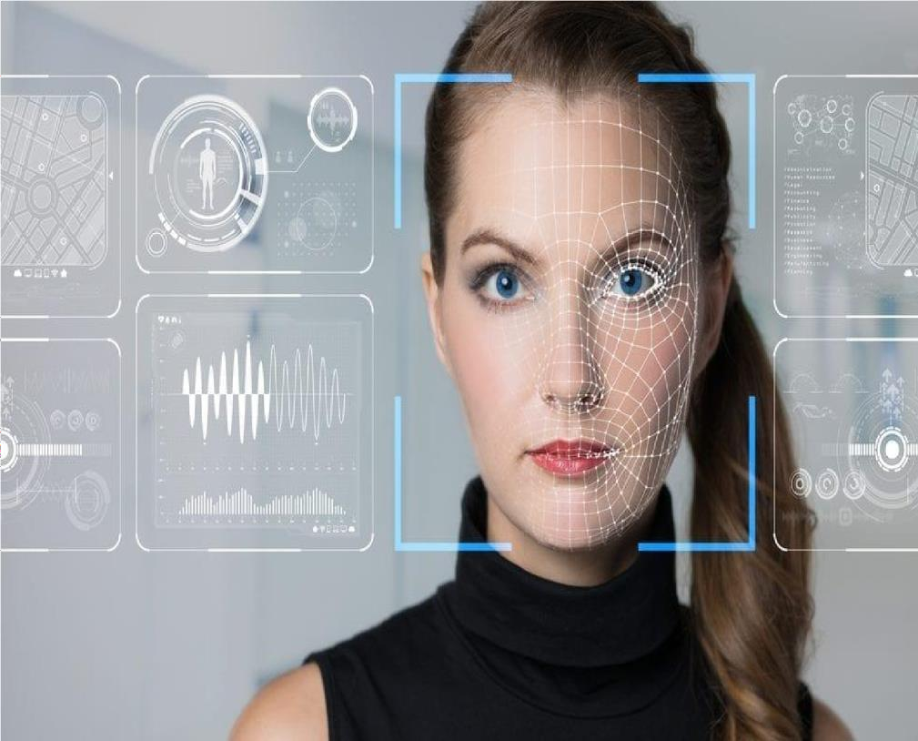
Content
Introduction
Defining Problem Statement
Data Summary
Dependency
Modelling Creation
Model evaluation
Challenges
Conclusion
Q&A
Introduction
Human emotions and intentions
are expressed through facial expressions and deriving angle.

Slide 3
efficient and effective feature is the fundamental component of facial expression system. Facial expressions convey non-verbal cues, which play an important role
in interpersonal relations. Automatic recognition of facial expressions can be an important component of natural human-machine interfaces. An automatic Facial Expression Recognition system needs to solve the following problems: detection and location of faces in a cluttered scene, facial feature extraction, and facial expression classification.

Slide 4
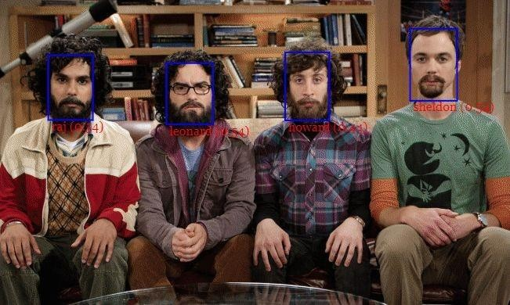
Defining Problem Statement
there are major challenges associated with digital learning when compared with brick and mortar classrooms.
One of many challenges is how to ensure quality learning for students. Digital platforms might overpower physical classrooms in terms of content quality but when it comes to understanding whether students are able to grasp the content in a live class scenario is yet an open-end challenge.
there are major challenges associated with digital learning when compared with brick and mortar classrooms. One of many challenges is how to ensure quality learning for students. Digital platforms might overpower physical classrooms in terms of content quality but when it comes to understanding whether students are able to grasp the content in a live class scenario is yet an open-end challenge. In a physical classroom during a lecturing teacher can see the faces and assess the emotion of the class and tune their lecture accordingly, whether he is going fast or slow. He can identify students who need special attention. Digital classrooms are conducted via video telephony software program (ex-Zoom) where it’s not possible for medium scale class (25-50) to see all students and access the mood. Because of this drawback, students are not focusing on

Slide 5
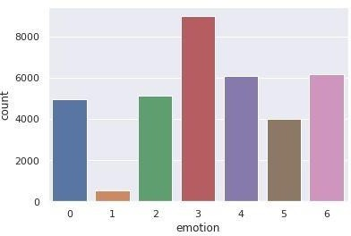
Data Summary
we have develop some deep learning model which detect the emotion of the students during the live class by the use of webcam so the teacher can understand that student are able to understand the topic or not. we take emotion of the student and
deploy that emotion into the
Sr.no | Face emotion
0 | Anger
1 | Disgust
2 | Fear
3 | Happy
4 | Sad
5 | Surprise
6 | Neutral

Slide 6
model our model is trained by fer2013 dataset which available on the kaggle.

Slide 7
Project Dependency
Python 3.0
Tensorflow 2.0
OpenCv
GPU must for faster computation
Anaconda Navigator spider for application code
Streamlit for the application deployment
Heroku for the application deployment

Slide 8
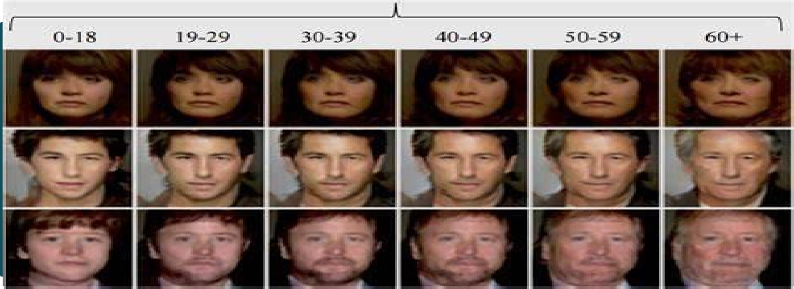
Model Creation(Deep face model)
Deepface is a lightweight face recognition and facial attribute analysis (age, gender, emotion and race) framework for python.

Slide 9
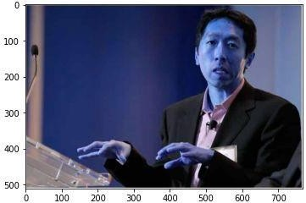
Deep face Prediction
Andrew Ng is the person Who has made this deep learning more intuitive for us.we want his presence in our dataset.
Deep face model detect correct emotion of the Andrew Ng .Model showing a 34 year old asian sad man which looking correct as per expression.

Slide 10
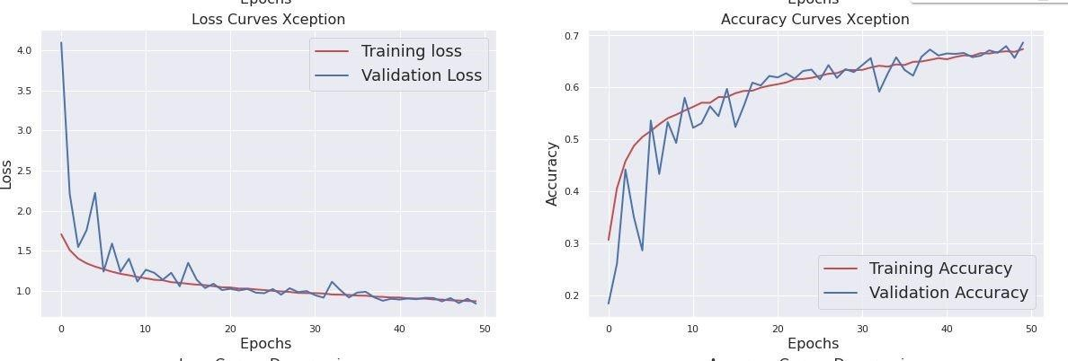
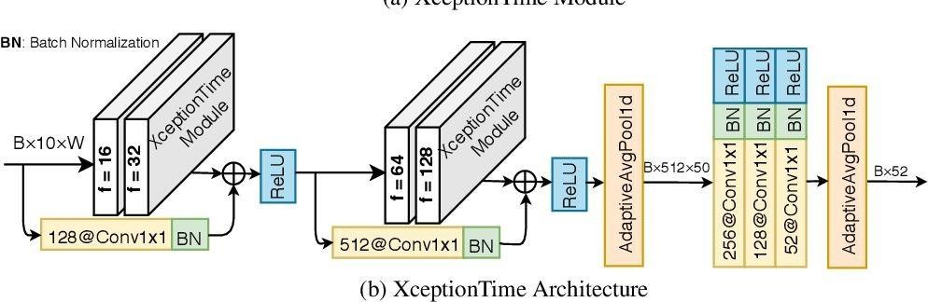
Model Creation(Xception model)
Xception architecture is a linear stack of depth wise separable convolution layers with residual connections.the Xception module has 3 main parts. The Entry flow, the Middle flow (which is repeated 8 times), and the Exit flow.

Slide 11
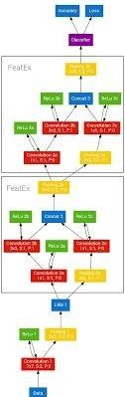
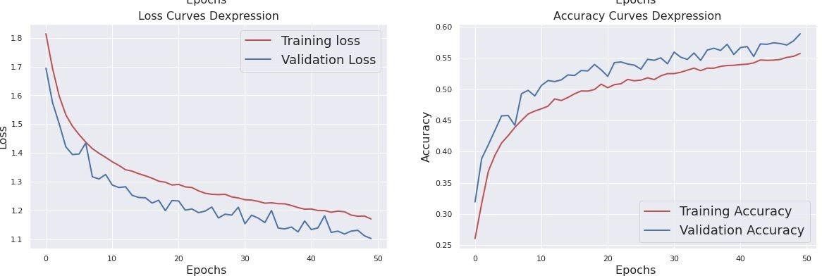
Model Creation(DeXpression model)
The proposed architecture is independent of any hand-crafted feature extraction and perform better then the basic Neural network but the training or validation accuracy is not good then the rest of four model.

Slide 12
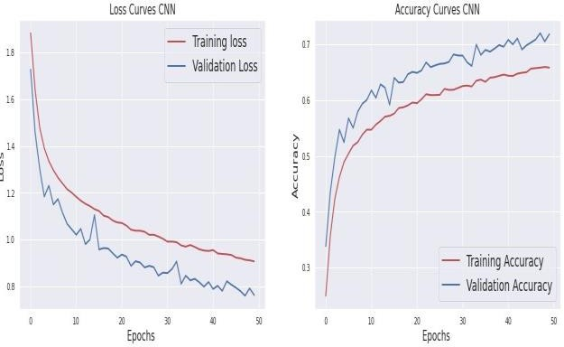
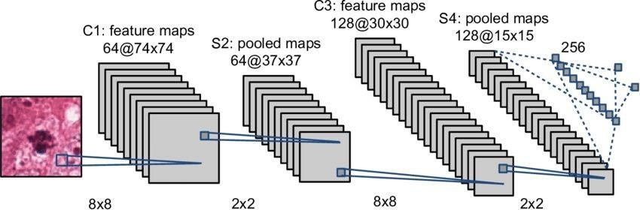
Model Creation(CNN model)
A Convolutional Neural Network (ConvNet/CNN) is a Deep Learning algorithm which can take an input image, assign importance (learnable weights and biases) to various aspects/objects in the image and be able to differentiate one from the other.

Slide 13
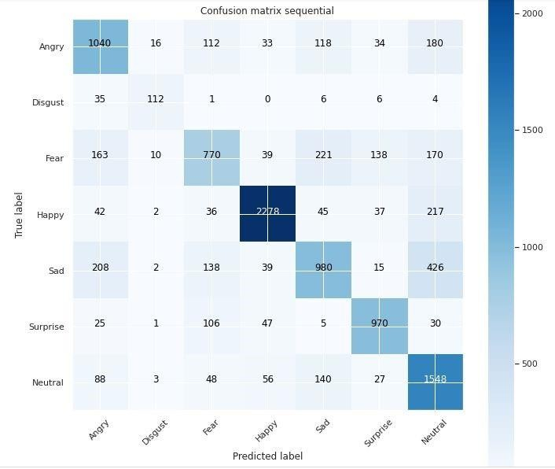
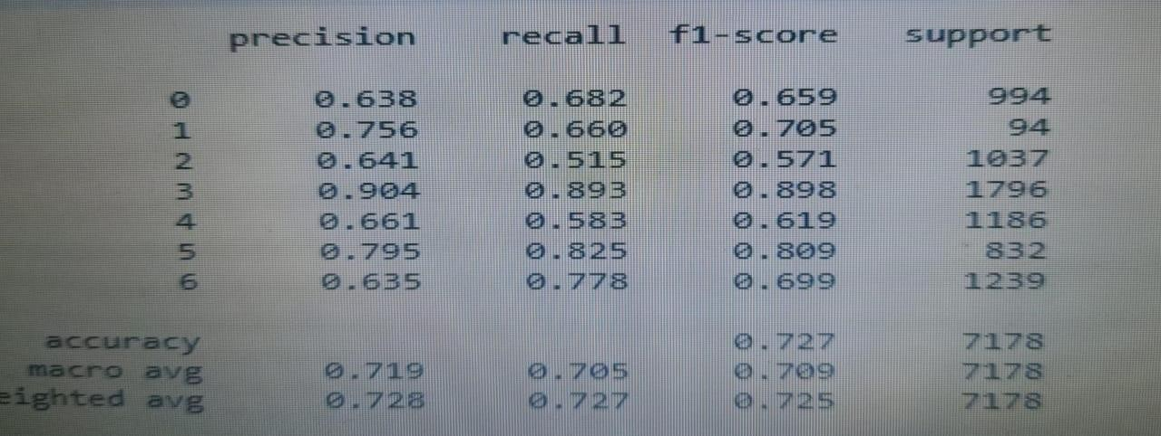
Confusion Matrix and Classification Record
Our CNN model having the best metrics score . we can see the performance in the confusion matrix as well as from the Classification record .and we found that this model have better recall score for all the expression

Slide 14
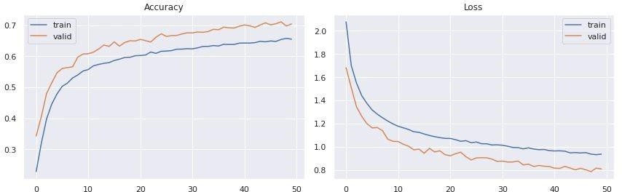
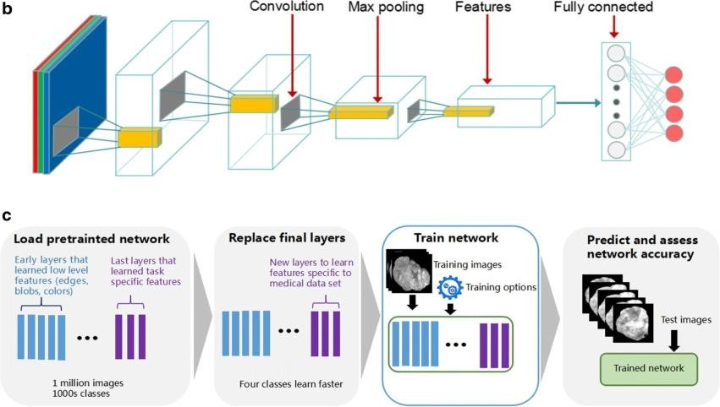
Model Creation(DCNN model OR ResNet50)
●
ResNet50 is a variant of ResNet model which has 48 Convolution
layers along with 1 MaxPool and 1 Average Pool layer. It has 3.8 x 10^9 Floating points operations. It is a widely used ResNet model and we have explored ResNet50 architecture in depth.

Slide 15
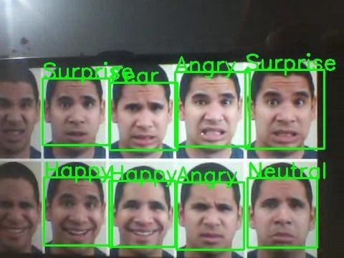
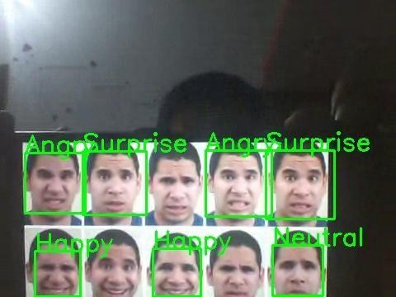
Real time local video face emotion detection
We created some pattern for detecting and prediction the emotion for single as well for the multiple face by the use of OpenCV video capture in local system.
For webapp OpenCv can’t use so we use streamlit-webrtc for Front end application.
Deployment of Streamlit Web App in Heroku and Streamlit:

Slide 16
This is Classification problem statement.
We deployed the app in Heroku if you saw in the starting section of github repo you see the all the requirement files are there for creating an app on Heroku of name “face-emotion-recognition-ofg”.
But due to high slug size the buffering takes time so we have ran our app working on local and it ran properly and app is also fine also
we’ve included video on github repo.
Heroku Link: https://proponent-ds.herokuapp.com/
Streamlit Link: Streamlit
Challenges
Large image dataset to handle
limited GPU access on Google colab notebook

Slide 17
Every training epoch takes too much time so experimenting with different data split which takes more time to give useful result.
hyper parameter tuning is very sensitive for these Neural Network model. So we make changes very careful
after seeing all the model score we need to find the best model based on different matrices score which is time consuming.because models takes lot of time to compute the result.
Conclusion
We build the WebApp using streamlit and deployed in Heroku and Streamlit Sharing.

Slide 18
The model which was created by custom CNN model gave training accuracy of 75% and test accuracy of 69%.which is maximum from the rest of all four models we used in this project.
we have also included the video of my WebApp working in Local. Local face detection help us to evaluate the performance after every small change in the code cell.
Codes ,which we deployed are present in Github Repository.
It was such an amazing and interesting project. We learnt a lot from this. We did lots of experiments with respect to data set distribution for the model and saw the effects on the performance.
Experience with this Project
Experiment is the key to enhance your learning boundary.

Slide 19
Never give up or keep searching the things till you not get the right one
Taking suggestion always be Good but take your imagination also when you need to take decision.
All new things come to update your skills so keep updating yourself.

Slide 20



